Slide 1
Group Meeting
Yue Hu
2018.08.23

Slide 2
Model1 --- Layered model
Model: 33*15m
Source: on the surface, 5-32 m, 1.5-m spacing, 19 sources
Station: on the surface, 6-29 m, 1-m spacing, 24 stations
Frequency: 25Hz
Bandpass: 2-20Hz

Slide 3
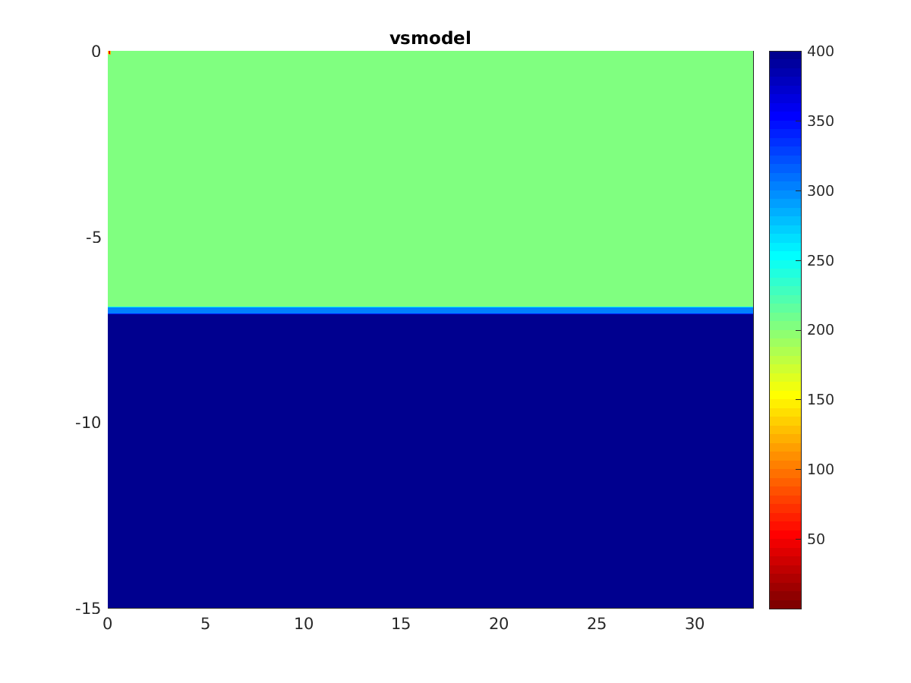
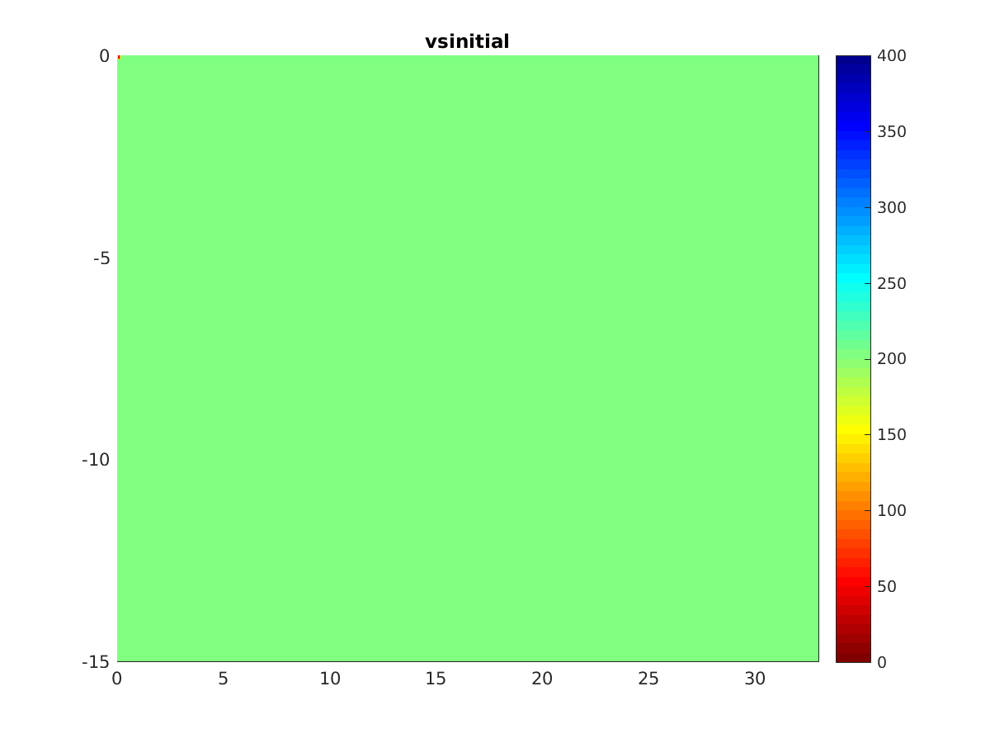

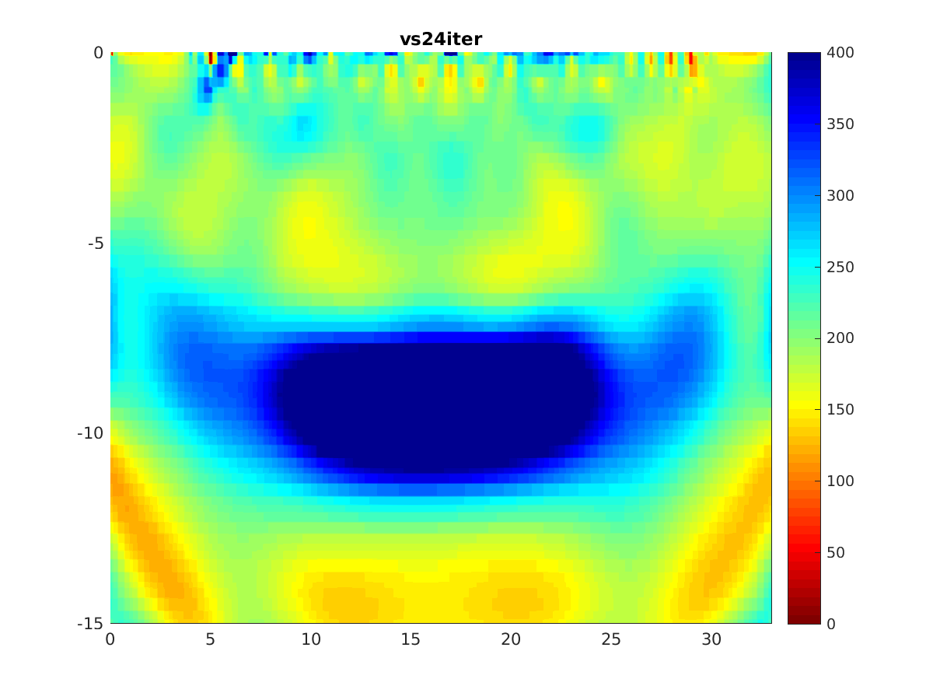
Model1 --- Layered model

Slide 4
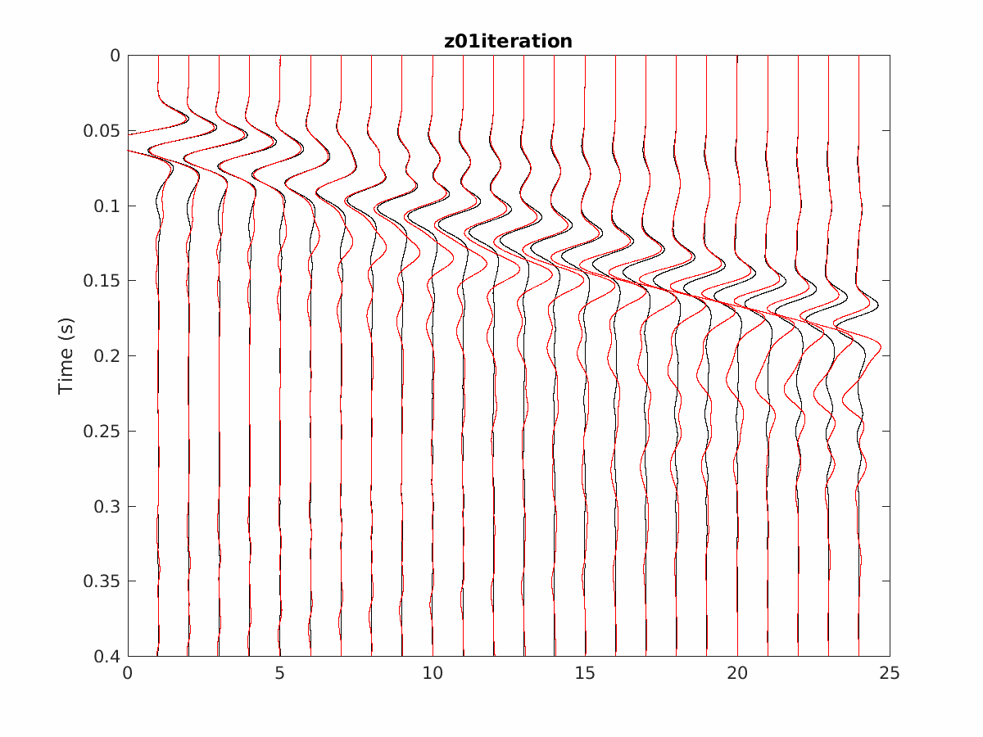
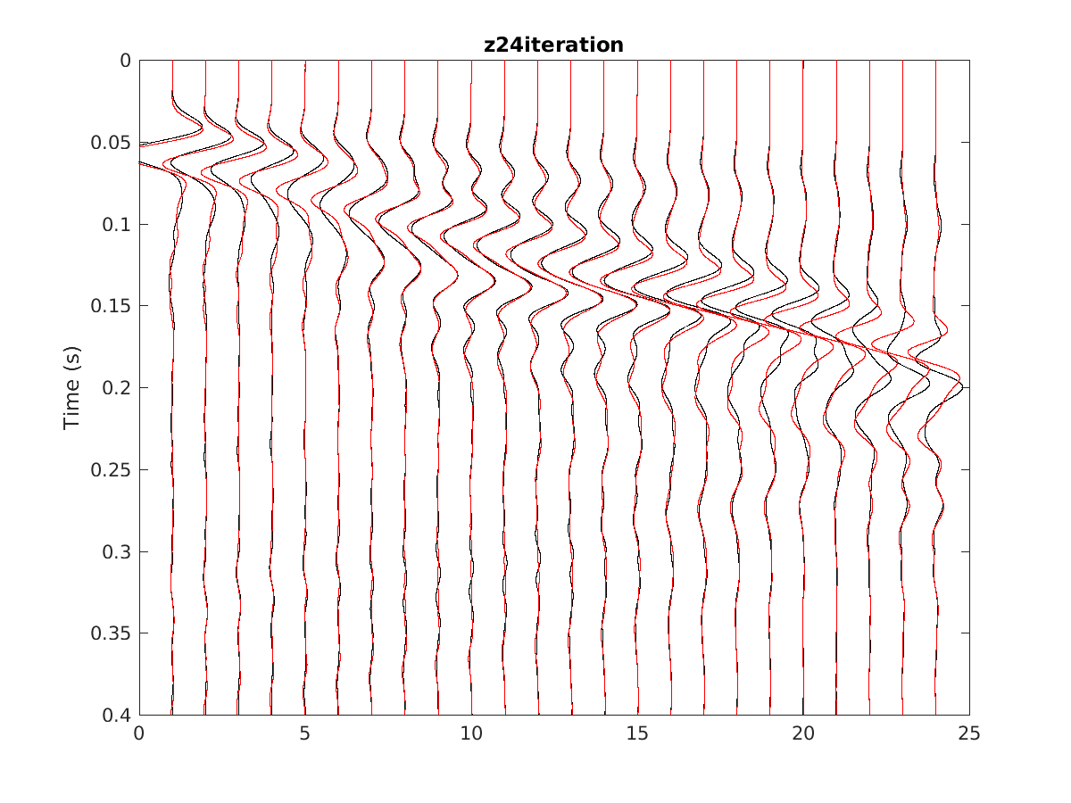
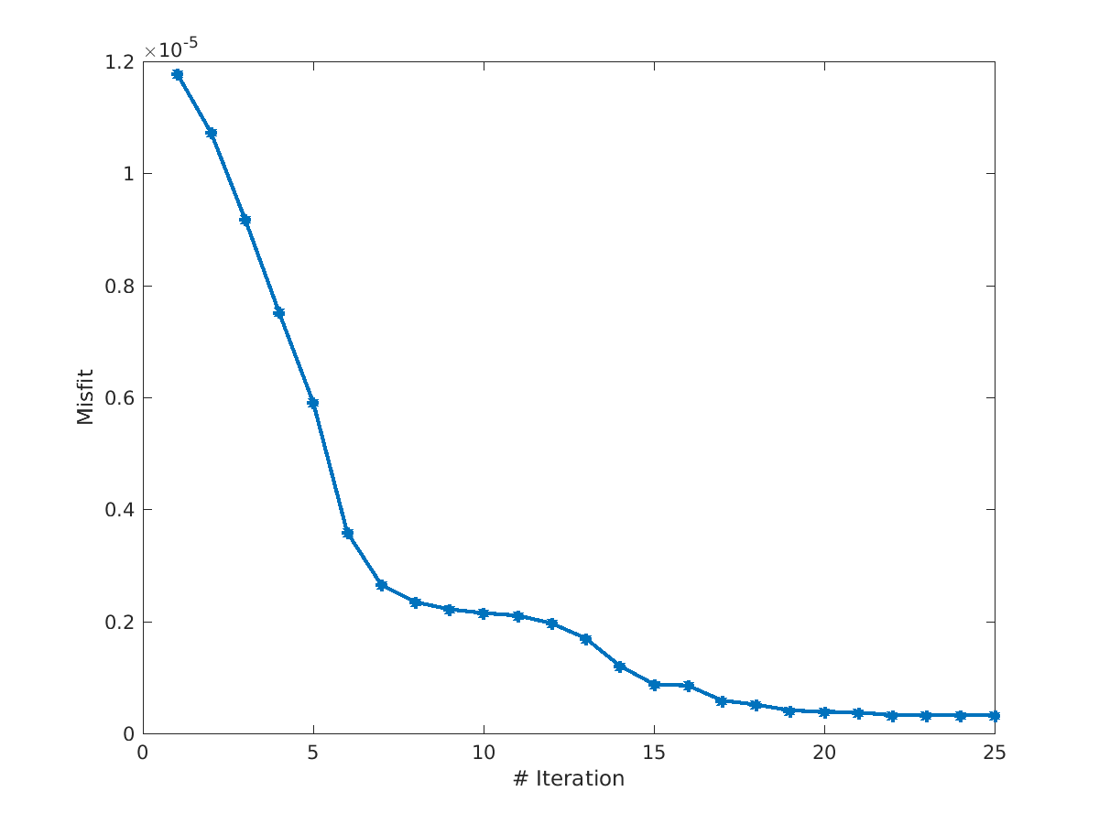

Slide 5
Model2 --- Fault model
Model: 60*30m
Source: on the surface, 5-57.5 m, 1.5-m spacing, 36 sources
Station: on the surface, 6-53 m, 1-m spacing, 48 stations
Frequency: 25Hz
Bandpass: 2-20Hz

Slide 6
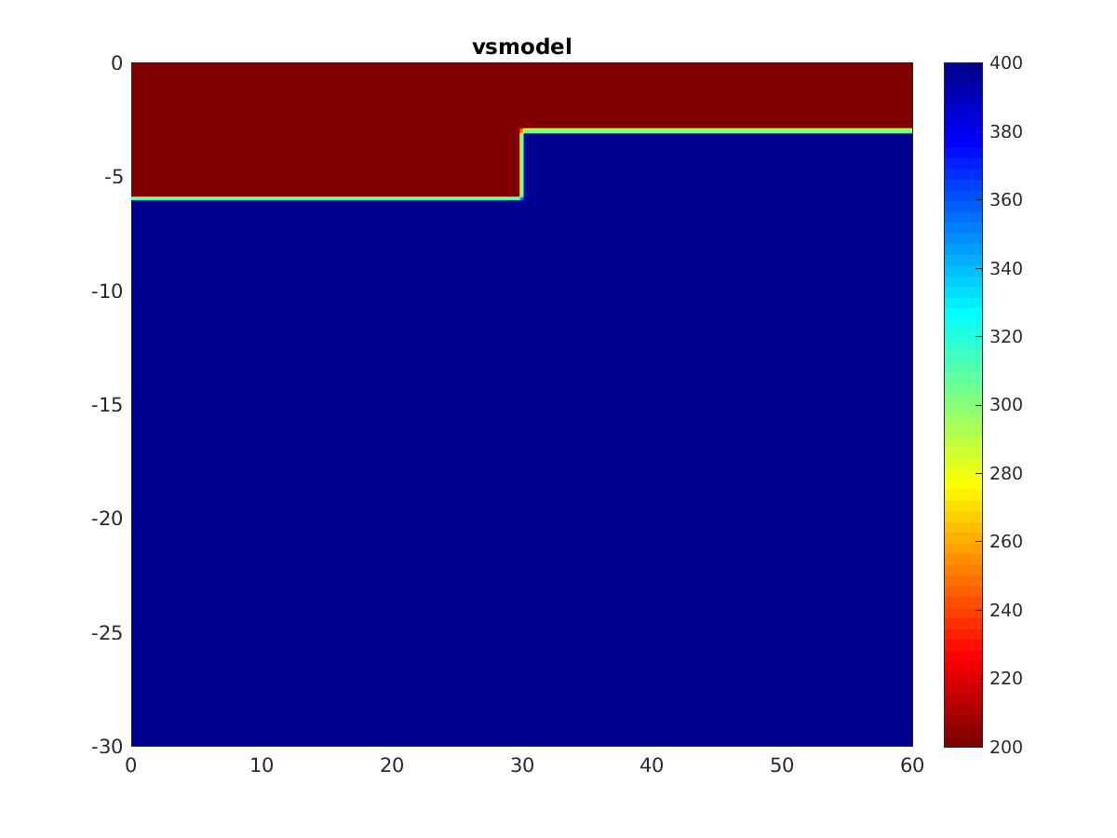
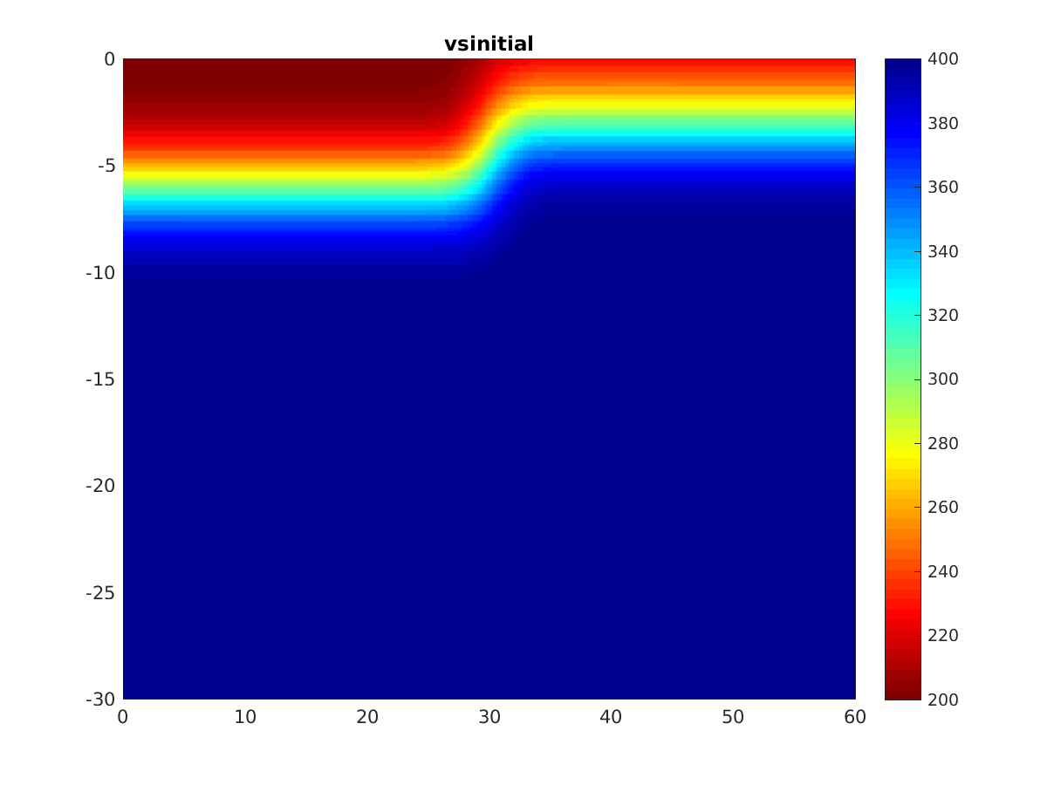

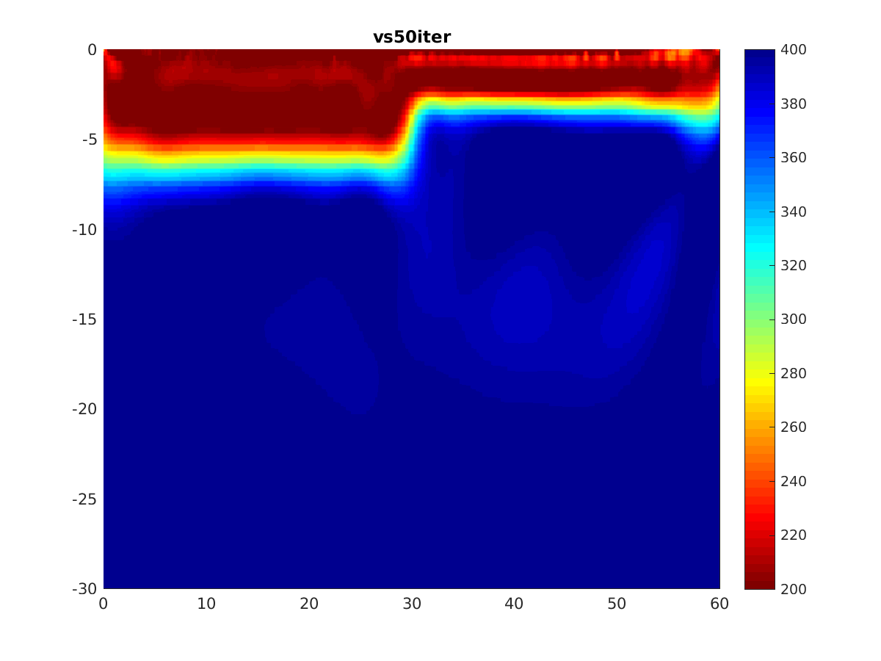
Model2 --- Fault model

Slide 7
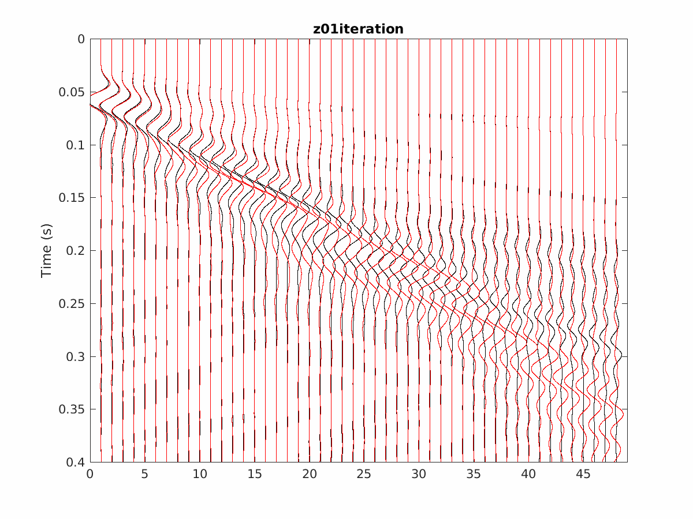
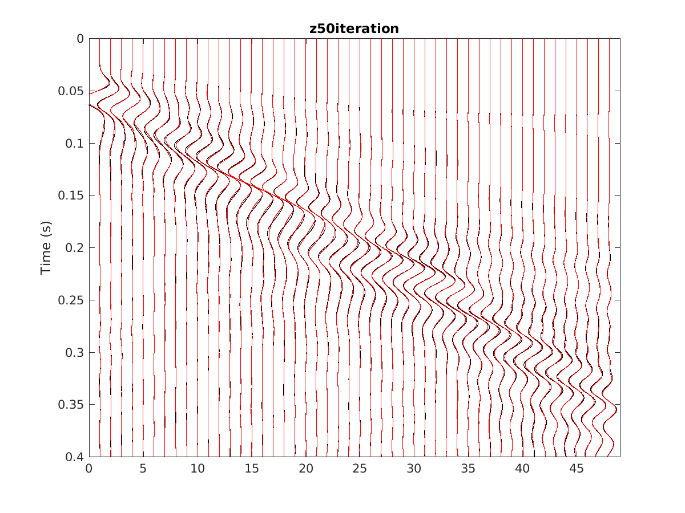
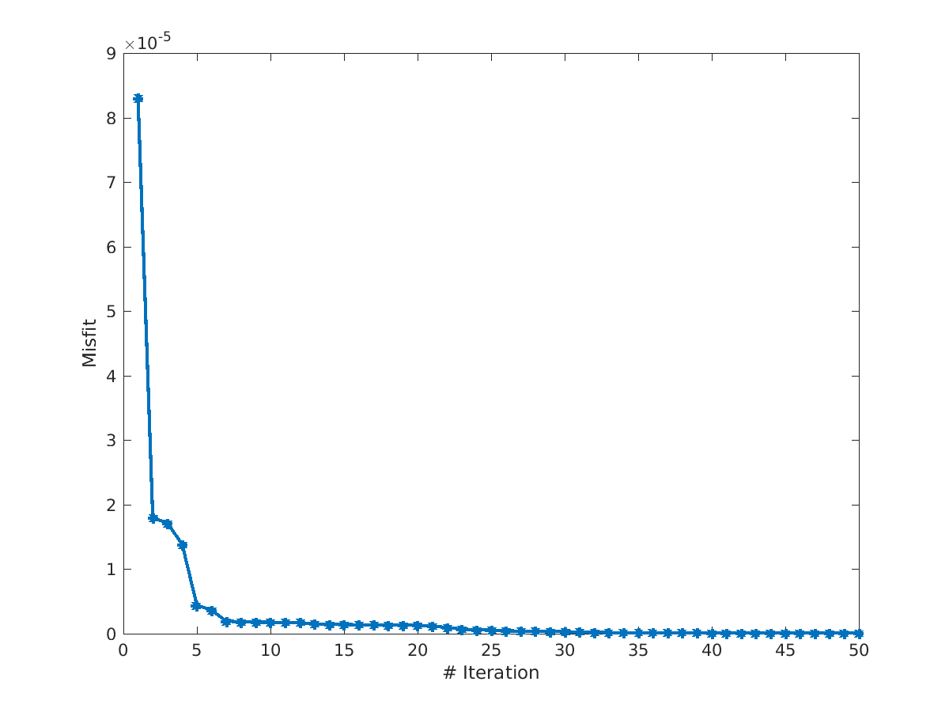

Slide 8
